Slide 1
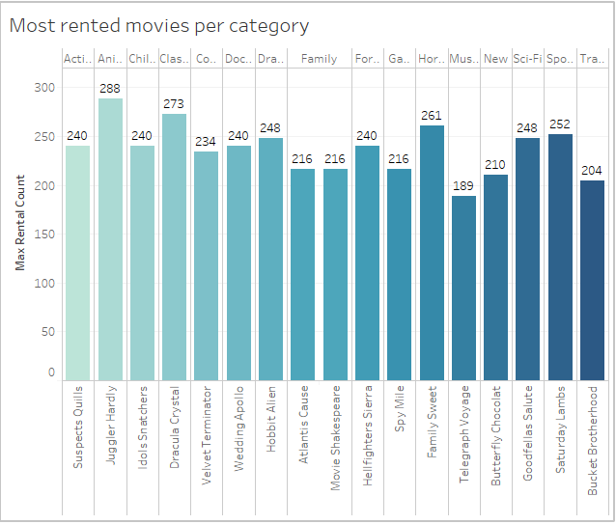
What are the most rented movies for each category?
<visualization>
From the bar chart, we can see that Juggler Hardly of the animation category was the highest rented film

Slide 2
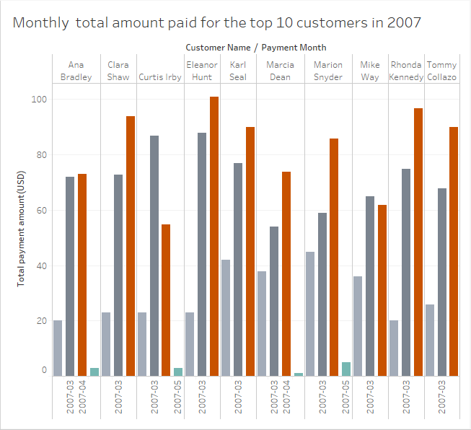
What was the monthly total payment amount in 2007 for the top 10 paying customers?
<visualization>
From the bar chat, Eleanor Hunt paid the highest on rental for 2007 with payment amount $100.78 in April

Slide 3
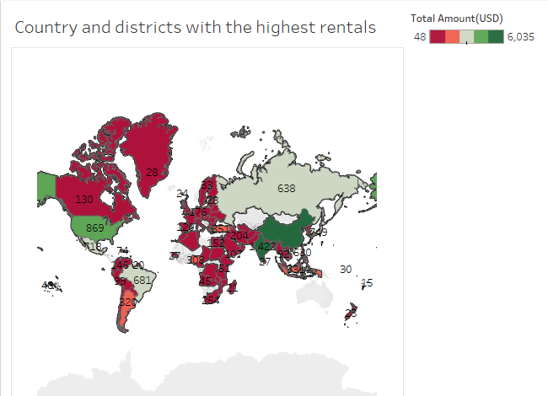
What country have the highest count in case the DVD rental company wants to open a new store?
<visualization>
From the visualization, China and India have the highest count and total amount spent on rentals, these countries will generate more income for the store if they are looking to open new stores

Slide 4
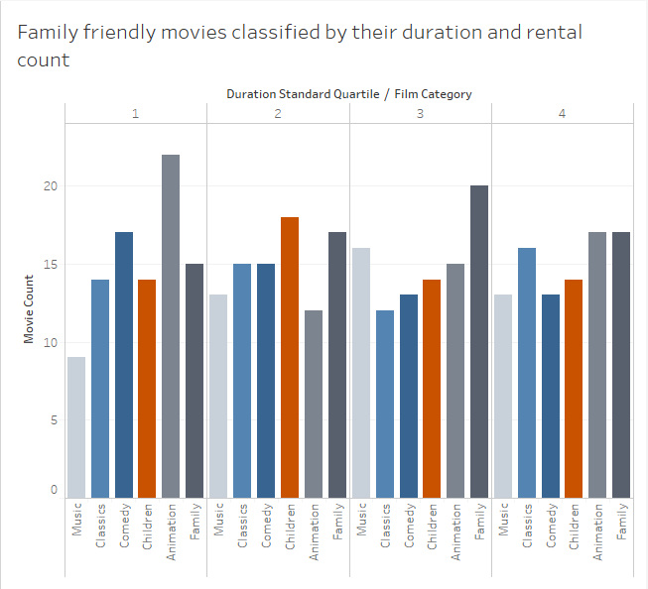
What were the highest family friendly films rented based on their length
<visualization>
From the visual, we can see that animation category was the most rented for the first quartile while Children, was the most rented for the second quartile, family for the third and then animation and family for the final quartile

